Slide 1
Welcome to Workplace Math 11

Slide 2
Introductions:
Ms. Sparling
Mx. Brammer
About you! (attendance)
What do sprinters eat before a race??

Slide 3
Course Set up: **pace of course
Similar to Workplace Math 10, course is designed to be self-paced if you would like to work ahead. However, you will be expected to stay within the schedule provided to avoid falling behind!
Course contains 7 units, each containing:
Unit Booklet- solved examples (notes), assignments and answer keys
Quizzes- 1 to 3 throughout each unit
Unit test

Slide 4
Course Supplies:
Binder for your booklets
Pencils/erasers
Calculator (phone calculator is fine for at home, but not in class as there are ones you can borrow!)

Slide 5
In Person Days:
If we are doing some examples together, they will be at the beginning of class. So please be ON TIME ☺ ***Example together will be faster than reading through the notes on your own!
If you are away, you are responsible for completing the work that was too be covered that day in class, and seeking out additional help at lunch if needed.
If you need to be away you can submit assignments to me via email.
Check my website for booklets/resources if needed: https://sparling.weebly.com

Slide 6
Classroom Expectations:
Phones (only for music for working when teacher is not talking) *headphones!
Swearing/bullying/harassment will not be tolerated
Arrive to class on time and ready to learn
Food and drinks:

Slide 7
GOALS!
Sticky notes

Slide 8
Assignments (20%)
Quizzes (30%)
Unit Tests (50%)
Room for change?
Conversations?

Slide 9
Graphs:
Ways of presenting data!
More visually appealing than just listing numbers in a chart

Slide 10
Joke time!
Why can’t Trump go to the White House anymore?
Quick Reminders: check off assignments from front page of booklet when done! This will remind you of when to ask for quizzes as well!
**answer key now online **graphs may vary! You may turn your booklet in for marking at the end of the unit, since you are now able to check your answers.
*missing page

Slide 11
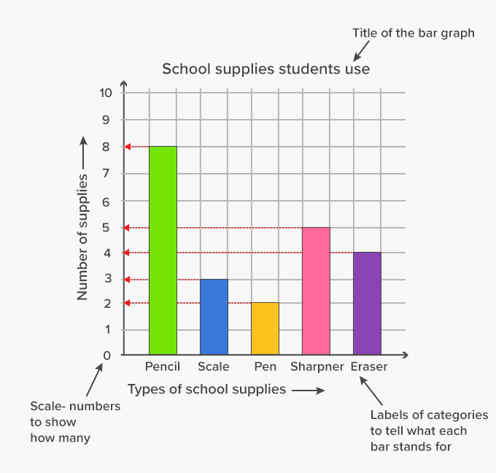
Bar Graphs
Vertical scale must start at 0!!! (unless you have negative and positive numbers)

Slide 12
Pg. 9 Bar Graph
Math Test Scores
60 65 70 75 80. 85 90 95
Test Score
There is one thing missing from this graph to get full marks.. What is it?

Slide 13
Pg.15 Broken Line Graph
Math Test Scores
60 65 70 75 80. 85 90 95
Test Score
There is one thing missing from this graph to get full marks.. What is it?

Slide 14
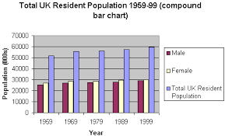
Double Bar Graph (or triple)
Used to compare two things
Ensure the bars for the same category are right beside each other
Trends?

Slide 15
Histograms:
Show continuous data over time, so bars are connected (no spaces between bars)
Vertical axis is a frequency of how many times the items on the horizontal axis occurred

Slide 16
Histograms:
How many different height categories are in this class of students?
2) How many students are in the class?

Slide 17
Circle Graphs:
-Compares parts of a whole
-In percentages
-What is easy to tell from
a circle graph?

Slide 18
Circle Graphs:
-Shown in percentage,
But for calculations we use
Decimals!
How to convert:
How to find percent of a number:

